Slide 1
GROUP PROJECT Course: Data Structures & Algorithms Dr: Tran Thanh Tung
Member:
đặng quốc cường
mai hoàng long
nguyễn lộc
nguyễn tiến dũng

Slide 2
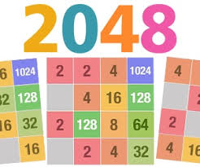
GAME

Slide 3
GAME PLAY
2048 is played on a gray 4×4 grid, with numbered tiles that slide smoothly when a player moves them using the four arrow keys. Every turn, a new tile will randomly appear in an empty spot on the board with a value of either 2 or 4. Tiles slide as far as possible in the chosen direction until they are stopped by either another tile or the edge of the grid. If two tiles of the same number collide while moving, they will merge into a tile with the total value of the two tiles that collided.[The resulting tile cannot merge with another tile again in the same move. Higher-scoring tiles emit a soft glow.
A scoreboard on the upper-right keeps track of the user's score. The user's score starts at zero, and is incremented whenever two tiles combine, by the value of the new tile.As with many arcade games, the user's best score is shown alongside the current score.
The game is won when a tile with a value of 2048 appears on the board, hence the name of the game. After reaching the 2048 tile, players can continue to play (beyond the 2048 tile) to reach higher scores.[When the player has no legal moves (there are no empty spaces and no adjacent tiles with the same value), the game ends.

Slide 4
GAME PLAY

Slide 5
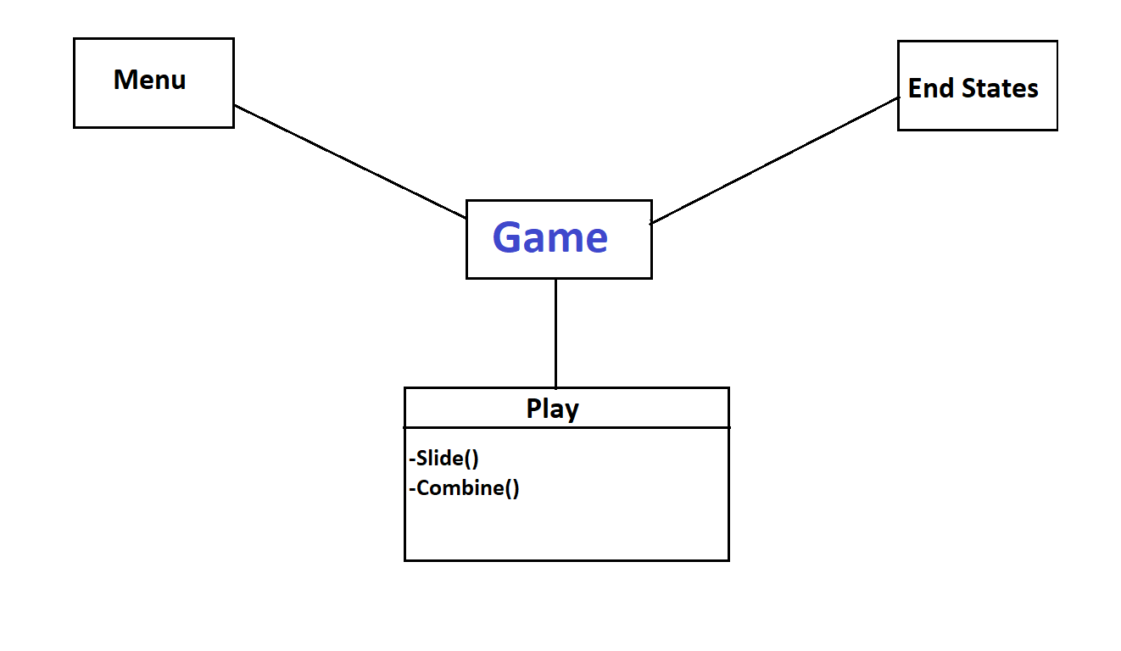

Slide 6
MODE 2: SPEED MODE
The number will appear in the board randomly every five seconds. The player has to play wisely to win the game.

Slide 7
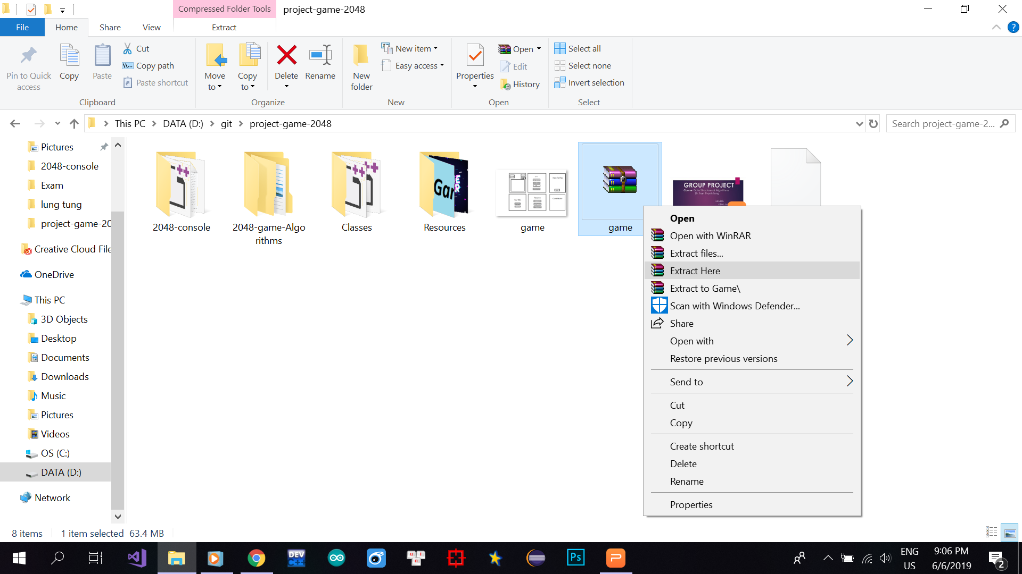
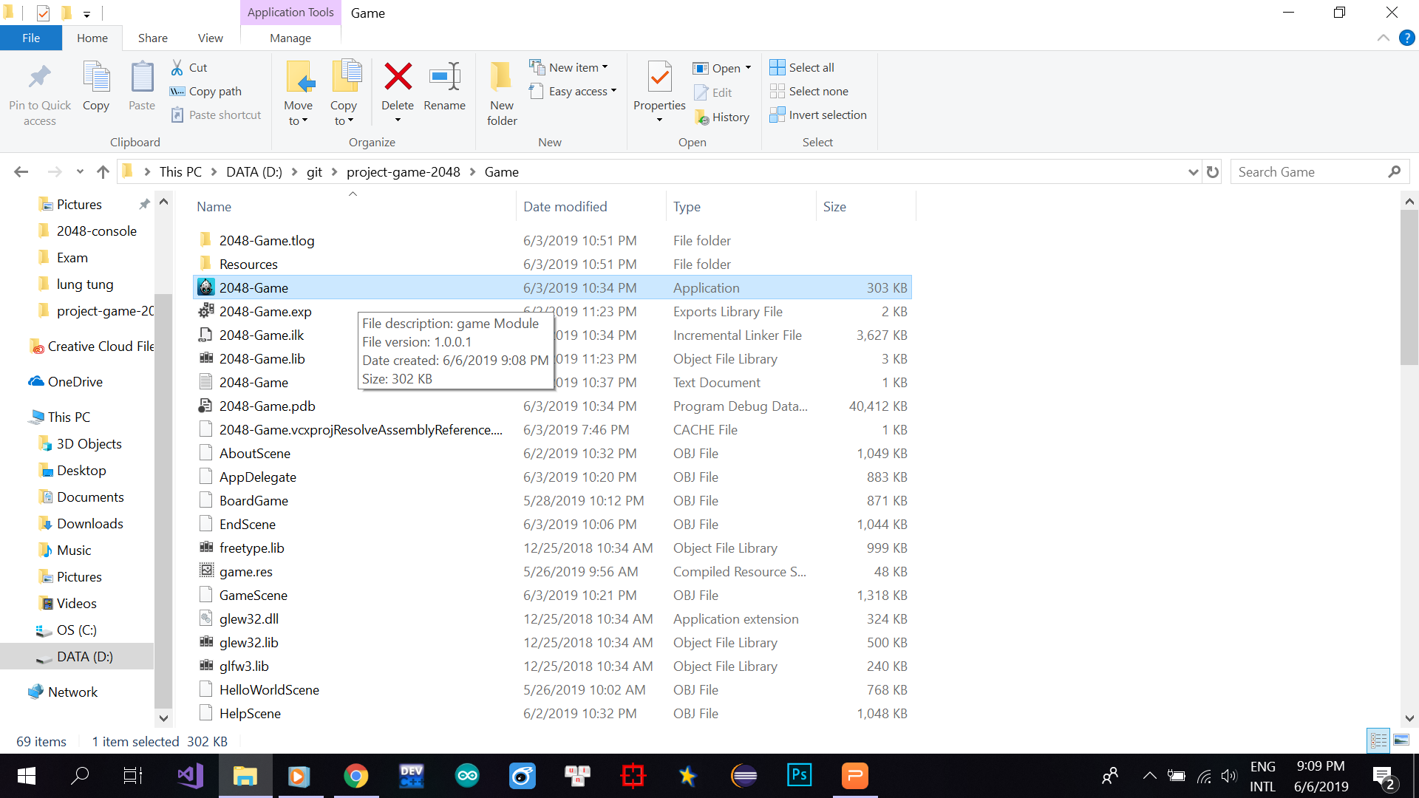
GUIDE TO INSTALL THE GAME
Step 1: Download the game.rar file through the following link :
Step 2: Click right mouse on the rar file you just downloaded and click “Extract here”. The password for the file is : “dsagame”.
Step 3: After the extraction, run the file “2048-Game” to enjoy the game.

Slide 8
GITHUB
Our github link: https://github.com/mailonggit/project-game-2048

Slide 9


